Slide 1
Deep Learning for Developers

Slide 2



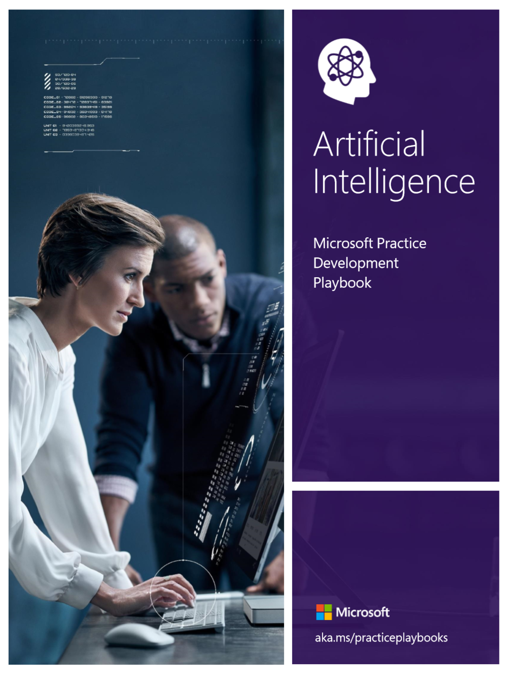
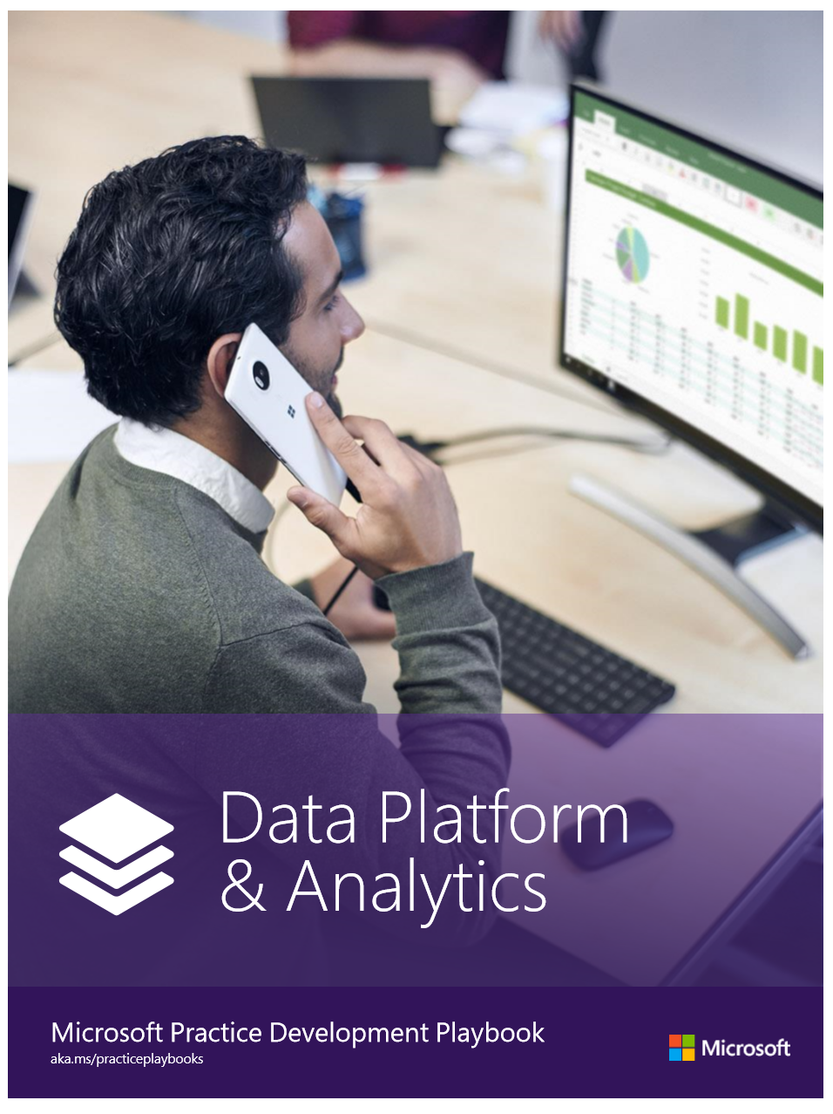
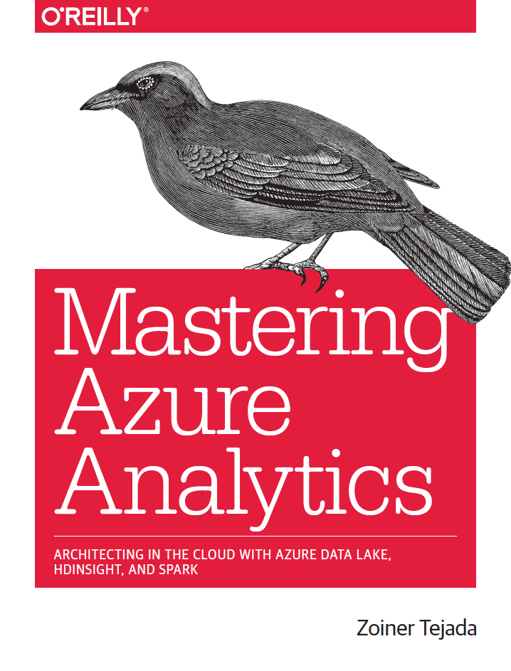
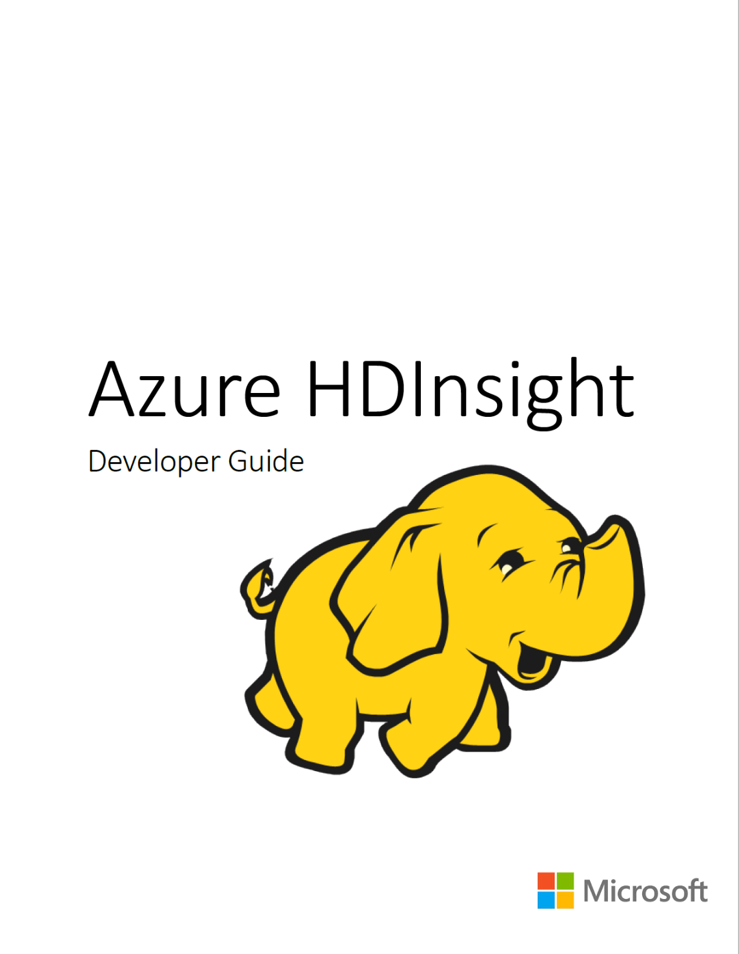
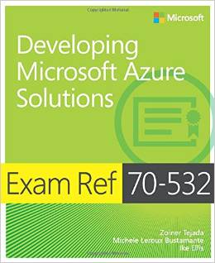
Solliance Founder, CEO
Author of a dozen books on Azure
Microsoft Azure MVP
Microsoft Regional Director
Zoiner Tejada
zoinertejada@solliance.net
@zoinertejada

Slide 3



Genisoft Founder, CEO
Microsoft Regional Director
Microsoft MVP – Artificial Intelligence
AI and Quantum geek
Ciprian Jichici
ciprian.jichici@genisoft.eu
http://ciprianjichici.ai

Slide 4
Abstract
Deep learning is at the center of many exciting application innovations, and yet deep learning is also a way you can safely upgrade your existing applications with powerful new capabilities. This hands-on workshop is not about extremely forward looking innovation with deep learners that will take many years and specialized experts to create- it is not about creating the next self-driving car or champion level video game playing agent.
This workshop IS about the innovations that you, the enterprise developer, can add to your applications today by learning just a few techniques and by having the confidence gained by knowing how such techniques are applied. Most enterprises have challenges with three kinds of data: structured data (think databases and time series), text and images or video. These are all data types for which deep learning has practical uses you can apply today. In this workshop you will train, evaluate and deploy deep learning models in Azure for each of these three data types, show casing techniques for text analytics/mining, computer vision and forecasting. These are fundamental techniques you will be able to apply to your applications after attending this workshop.
So sign-up, come with your fully charged laptop and let’s get some innovation tackled together.

Slide 5

Workshop Agenda:
Time | What
9:00 - 10:00 | Deep Learning in Azure Backgrounder
10:00 - 10:30 | Lab 1: Notebook Fundamentals Follow Along Lab (Azure Databricks)
10:30 - 11:30 | Fundamental Concepts of Deep Learning
11:30 - 12:00 | Lab 2: Deep Learning Fundamentals Lab (Azure Databricks)
12:00 - 1:00 | Lunch
1:00 - 2:15 | Lab 3: Deep Learning for Text Analytics (AML)
2:15 - 3:45 | Lab 4: Image classification with Deep Learning (Azure Databricks)
3:45 - 4:00 | Wrap Up and Q&A
Notes:
Lab 1 – Azure Databricks \ Learning Paths \ DS \01 Notebook Fundamentals: 01 Notebook Fundamentals
Lab 2 – Azure Databricks \ Learning Paths \ DS \ 04 Deep Learning: 01 Deep Learning and 02 Neural Nets basic concepts
Lab 3 – Azure Notebooks \ Tech Immersion Prod : deep-learning
Lab 4 – Azure Databricks \ Learning Paths \ DS \ 04 Deep Learning: 04 Image classification with Azure Databricks

Slide 6
A bit of advice…
If you don’t know, the thing to do is not to get scared, but to learn.
- Ayn Rand, Atlas Shrugged

Slide 7
How not to learn deep learning
Most materials follow this approach:
What’s the problem?
History
Not usually relevant to your code
Theory
Can be overwhelming
Math
Takes extra time and effort to understand
Concepts
Code
Best Practices
Only to discover that in practice nobody does it that way!
Background Research
Prep Session
Capabilities Presentation
Q&A Interview
Additional Documentation & Follow-Up Clarifications

Slide 8
How to learn deep learning
Instead follow this approach:
Guidance:
Best Practices
Concepts
Learn by doing, often.
Code
Stop here (usually)
Theory
Instead of pursuing these depths, use that time for other best practices, concepts and code!
Come back to these after you’ve had your initial experience!
Math
History
Background Research
Prep Session
Capabilities Presentation
Q&A Interview
Additional Documentation & Follow-Up Clarifications
Notes:
Start your learning with the known best practices – there are established patterns and good defaults
Learn the concepts that inform the decisions you need to make
Code in an iterative fashion, start simple, and layer in complexity

Slide 9
What is Artificial Intelligence?
AI refers to scenarios where a machine mimics the cognitive functions associated with human minds, such as learning and problem solving.
1
Because AI leverages machine learning algorithms, it is viewed as an umbrella term covering Machine Learning and Deep Learning.
2

Slide 10
What is machine learning?
Machine learning gives "computers the ability to learn without being explicitly programmed."

Slide 11
Machine learning and deep learning
Artificial Intelligence
Machine Learning | Deep Learning
Different approaches to a similar goal.
X
f(x)
Y
The goal is learning a way to meaningfully transform data, to learn useful representations of the input data to get us closer to the expected output.

Slide 12
What do you really need to know to do machine learning?
Computer Science
Domain Expertise
Math
There’s an argument being made that only data scientists can do ML because they come from the math side.
How many developers do you know that are actually bad at math?

Slide 13
How much math did we write in this code?
from keras import models
from keras import layers
network = models.Sequential()
network.add(layers.Dense(512, activation='relu', input_shape=(784,)))
network.add(layers.Dense(10, activation='softmax’))
network.compile(optimizer='rmsprop',
loss='categorical_crossentropy',
metrics=['accuracy’])
network.fit(train_images, train_labels, epochs=5, batch_size=128)

Slide 14
Deep learning and math
Machine learning and deep learning exhibits comparatively little mathematical theory [compared to statistical analysis] and is engineering oriented.
It’s a hands-on discipline in which ideas are proven empirically more often than theoretically.
- Francois Chollet, Creator of Keras

Slide 15
Machine Learning as the new programming paradigm
Rules
Traditional Programming
Answers
Data
Data
Machine Learning
Rules
Answers
Let the machine figure out the rules based on history!

Slide 16
As a developer is deep learning for you?
In the future, deep learning will not only be used by the specialists- researchers, graduate students and engineers with an academic profile- but will also be a tool in the toolbox of every developer, much like web technology today.
- Francois Chollet, Creator of Keras

Slide 17
As a developer, what technologies do you need to learn?
Python
Azure Compute
Azure Storage
Azure Machine Learning

Slide 18
Introducing the Data Science Process
Collect Data
Prepare Data
Train Model
Evaluate Model
Deploy Model
Re-train
Model
Notes:
Collect Data
Prepare Data
Perform data wrangling to get the data in a format suitable for analysis
Explore and understand the data
Identify or create the features needed for your model
Train Model
Select the algorithm
Prepare training, testing and validation data sets
Iteratively evaluate model to identify best performing version and sanity check outcome
Evaluate Model
Run the model thru a final exam using data from your validation data set and see how it performs
Deploy the Model
Package the model and dependencies up for deployment
Use it in a web service or within an API in an application
Measure the ongoing performance of the model
Retrain
As the data environment changes and affect model performance, retrain the model on fresh data

Slide 19
The Data Science Process (Developer Lens)
Collect Data
Prepare Data
Train Model
Evaluate Model
Deploy Model
Re-train
Model
Write Code
Write Queries & Code
Write Code Do some math
Write Code Do some math
Do DevOps

Slide 20
The Pre-Built and Custom AI Spectrum
Pre-Built AI
Custom AI
Azure Cognitive Services
Azure Machine Learning
Pre-built models
Custom models
Models are pre-trained using Microsoft supplied data
Models “customized” with your data
Models tailored to your scenario and your data

Slide 21

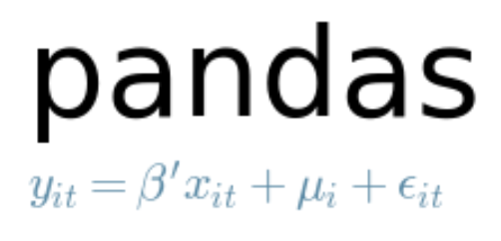








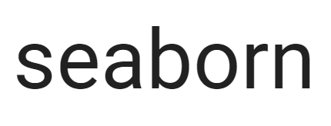


Examples of Tools for Data Science in the Wild
Core frameworks and tools
Machine Learning & Deep Learning
Keras
PyTorch
Visualization

Slide 22







How can we do data science on Azure?
Azure ML
Spark on HDInsight
Azure Databricks
SQL Server Machine Learning Services
Data Science or Deep Learning VM
Azure Notebooks
ML Server

Slide 23
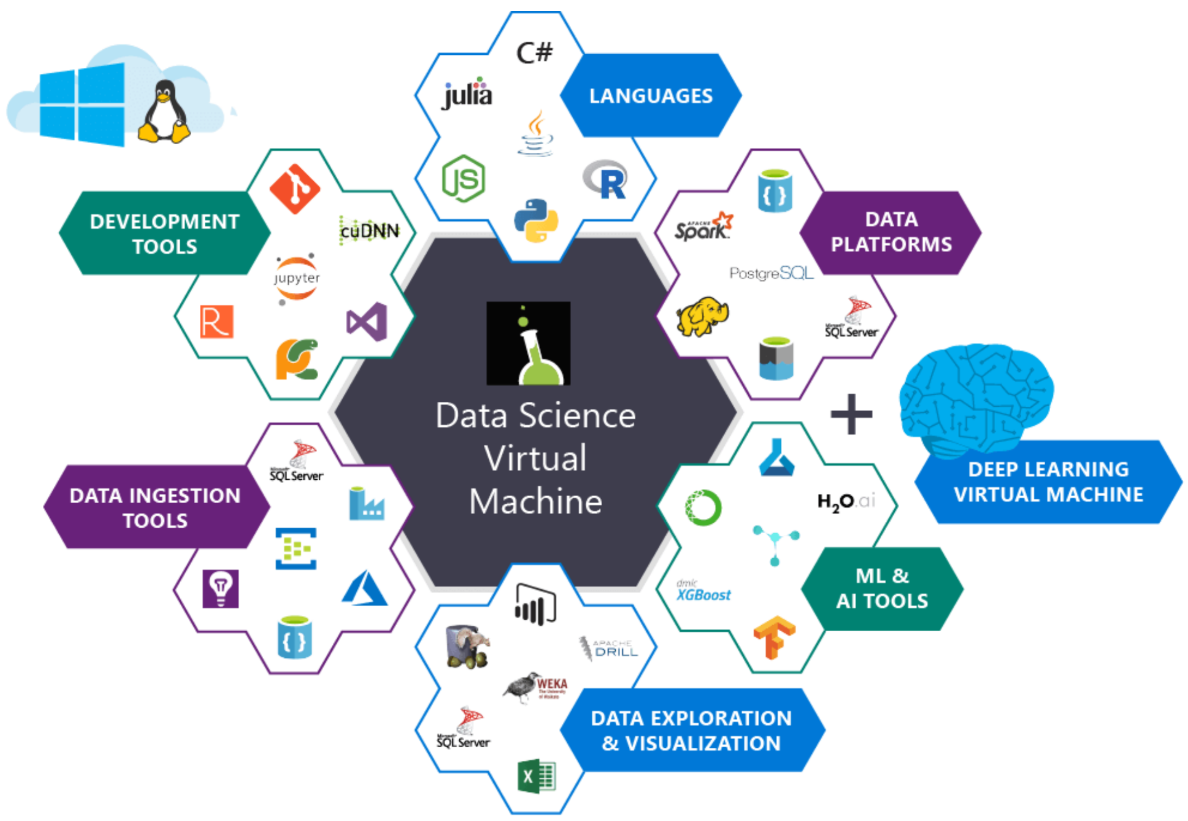
Data Science VM

Slide 24








Data Science End-to-End with Azure
Train and test a model
Local Training
Remote Training
Local Machine
Data Science Virtual Machine
Azure Databricks
AML Compute
SQL Server ML Services
Model Training
Local Jupyter Notebook
Jupyter Notebook
Azure Databricks Notebooks & Clusters
Any AI framework
R in T-SQL
Local Visual Studio Code
Visual Studio Code
Docker container
Python in T-SQL
Local Docker container
Docker container
Containerized Model
Serialized Model
Docker
Azure Kubernetes Service / ACI
Azure Databricks
Core ML
SQL ML Services
Model Operationalization
Local container scoring web service
Containerized scoring web service
Model used in
batch scoring notebooks & jobs
Predictive stored procedure in SQL Server
Model embedded in iOS mobile app
Local Scoring
Remote Scoring
Make predictions

Slide 25










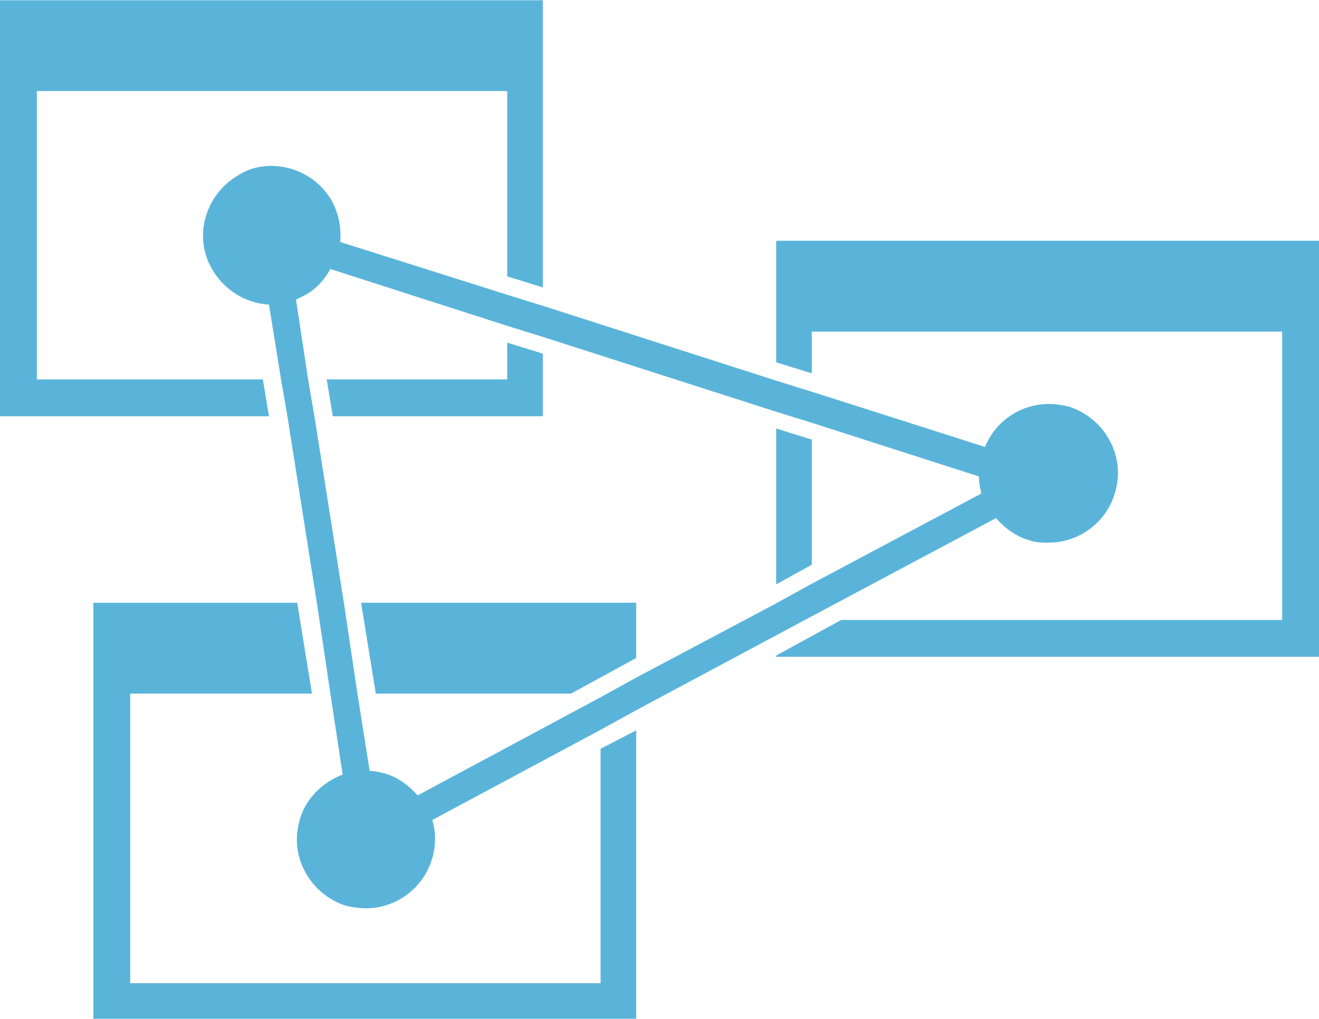



Advanced analytics pattern in Azure
Performing data collection/understanding, modeling and deployment
MODEL TRAINING
SERVING STORAGE
AZURE ML
ML SERVER
AZURE DATABRICKS (Spark ML)
SQL Server (In-database ML)
DATA SCIENCE VM
SENSORS AND IOT
(UNSTRUCTURED)
COSMOS DB
LONG TERM STORAGE
DATA PROCESSING
APPLICATIONS
SQL DB
r
LOGS, FILES AND MEDIA (UNSTRUCTURED)
SQL DB
AML COMPUTE
SQL DW
DATA LAKE STORE
AZURE STORAGE
COSMOS DB
AZURE DATABRICKS
HDINSIGHT
ORCHESTRATION
TRAINED MODEL HOSTING
AZURE ANALYSIS SERVICES
BUSINESS / CUSTOM APPS
(STRUCTURED)
SQL SERVER (In-database ML)
DASHBOARDS
AZURE KUBERNETES SERVICE
DATA FACTORY

Slide 26
The Notebook Paradigm
Collect Data
Retrieve Files
Evaluate
Model
Test Performance
Query SQL Databases
Compare Models
Call Web Services
Validate Model
“Scrape” Web Pages
Visualize Performance
Execute arbitrary:
- Python code
- R code
- SQL queries
- Shell commands
Prepare Data
Explore Data
Deploy
Model
Export Model File
Validate Data
Prepare Job
Clean Data
Deploy Container
Featurize Data
Re-package Model
Notebook
(Jupyter, Azure Databricks)
Train Model
Prepare Training Set
Experiment
Test Model
Visualize Performance

Slide 27
Lab Setup
Browse to:
TBD
Register
You may use fake info if you prefer, the system just emails you your password for the day.
Activation Code:
TBD
Get access to your provided Azure subscription.

Slide 28
Lab 1
Login to your Azure subscription
Open your Azure Databricks Workspace
Import the notebook DBC from http://bit.ly/deep-learning-for-devs
In your Workspace open 01 Notebook Fundamentals
Complete this notebook:
01 Notebook Fundamentals
Attach to cluster
Get hands-on with notebooks for the first time.
Duration: 30 minutes

Slide 29





Deep learning applications
A / अ
language translation
autonomous vehicles
Image recognition
predictive analytics
speech recognition
forecasting
And much more…

Slide 30
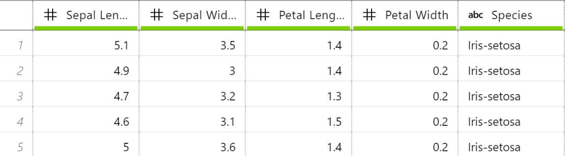
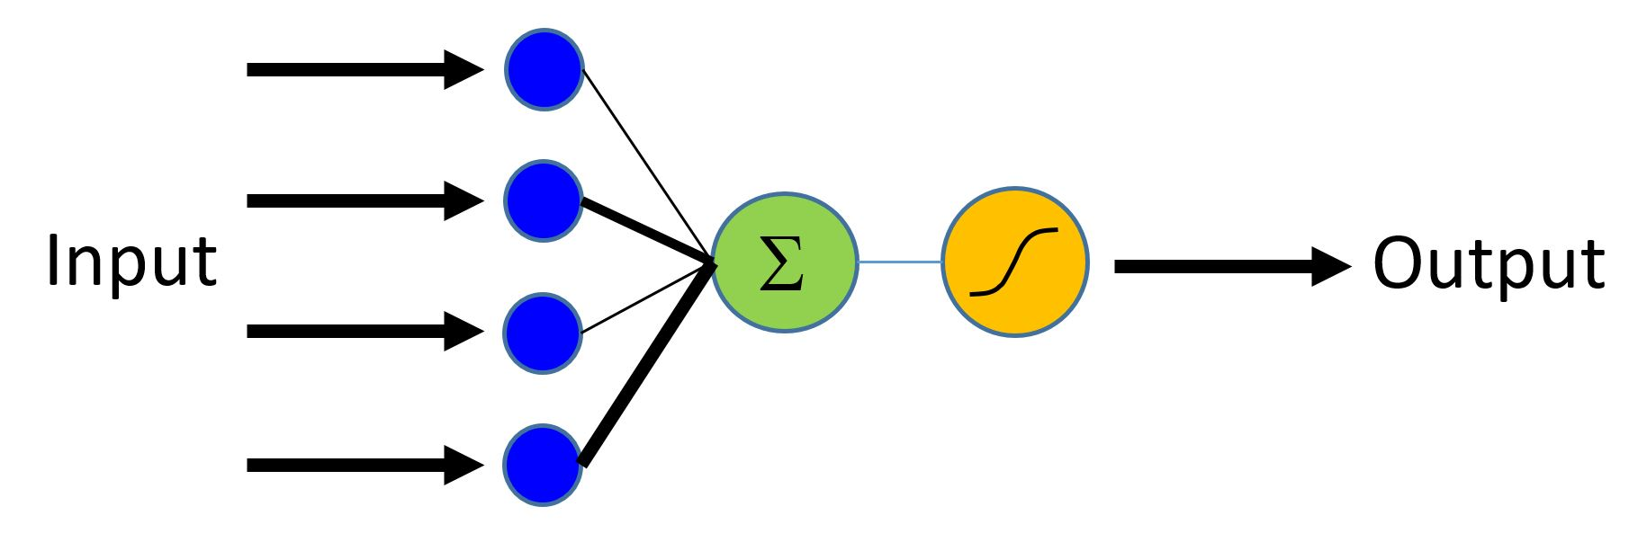
Machine Learning & Deep Learning Compared
Example using a binary classification with logistic regression
Features
Labels
ML trains
an equation:
Deep learning trains a graph:
y=mx+b
Ultimately both can predict a value of 0 (not iris-setosa) or 1 (is iris-setosa)

Slide 31
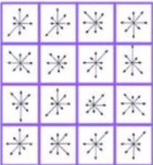

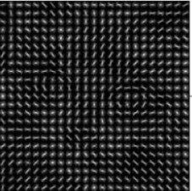
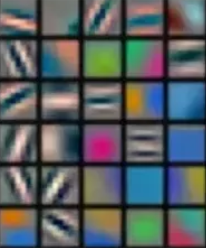
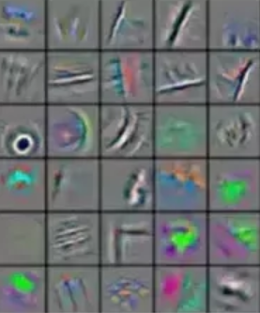
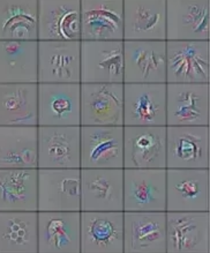


Deep learning vs. traditional ML
ML
Cat
Dog
Other
manual feature extraction
classification algorithm
DL
Cat
Dog
Other
feature learning + classification

Slide 32
Characteristics of Deep Learning
Massive amounts of training data
Excels with raw, unstructured data
Automatic feature extraction
Computationally expensive
GPU

Slide 33
Text analytics applications
Text
Summarization
Semantics
Sentiment
Classification
Clustering
Search
Make sense of unstructured data.
Notes:
Text
Semantics: Meaning and Sentiment Detection
Summarization: Key Phrase/Entity Extraction, Topic Detection, Automated Document Summarization
Classification: Binary, Multi-class and Multi-label classification
Clustering: Term Similarity, Document Similarity, Document Clustering
Search

Slide 34
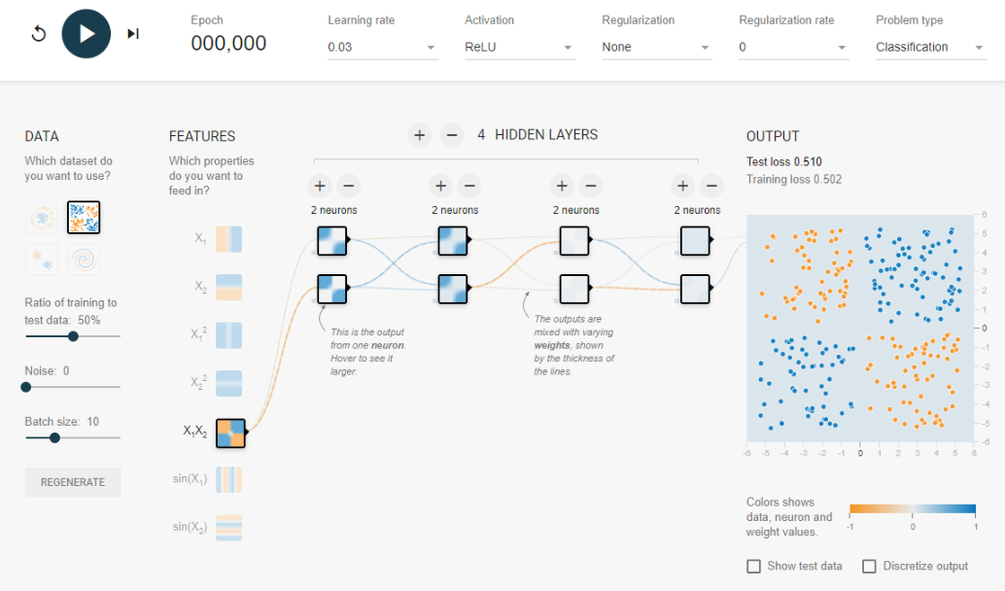
Fundamental Concepts - Visualizing a Neural Network

Slide 35
Understand the data and the goal
Classification or Regression
We have two classes of data (orange and blue).
We want to train a model that given some input data, it can classify it as orange (-1) or blue (+1).

Slide 36

Define a network architecture
Decide on the network architecture, basically:
how many layers
how many neurons in each layer
how the neurons in each layer are connected (fully or partially)

Slide 37
Define shape of input data
Define how the input data (the features X1 and X2) are provided to the model.
Here we choose to multiply the features and provide the result as the input.

Slide 38
Set parameters – learning rate
The model makes small changes during each epoch (which is a complete pass thru the training data).
Just how big is controlled by the learning rate.

Slide 39
Set parameters – activation function
The activation function is a mathematical function that introduces non-linearity to the output of the network. Adding these enables the neural network to learn using a richer hypothesis space than just linear transformation of the input data.
ReLU (pronounced ray-luh) sets negative values to zero and passes thru positive values unchanged. It is arguably the best practice activation function.

Slide 40
Set parameters - Regularization
Regularization smooths the curves of the model, so that it doesn’t hug the training data too tightly.
It helps avoid the problem of overfitting, where the model basically just memorizes the outcomes of all of the data points, but fails against new data points.

Slide 41
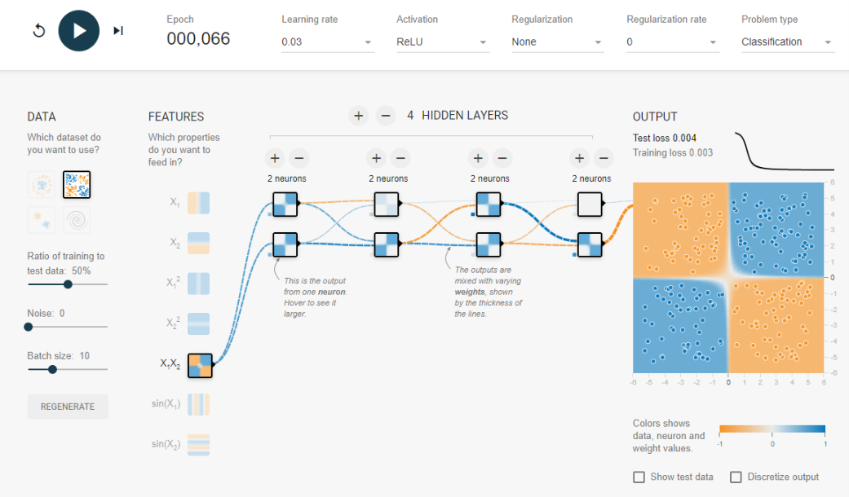
Training – The forward pass
Then we run the training data (the data and the class) thru the network. This is called the forward pass.
In each epoch we run thru the entire training data set.
At the end of the epoch, our model has made certain predictions (which for the first few epochs are almost certainly wrong because they are random).

Slide 42
Training – Evaluate loss
Given that we know the correct class and the class predicted by the model, we can assess the model’s performance at the end of each epoch.
The measured error is called the loss.

Slide 43
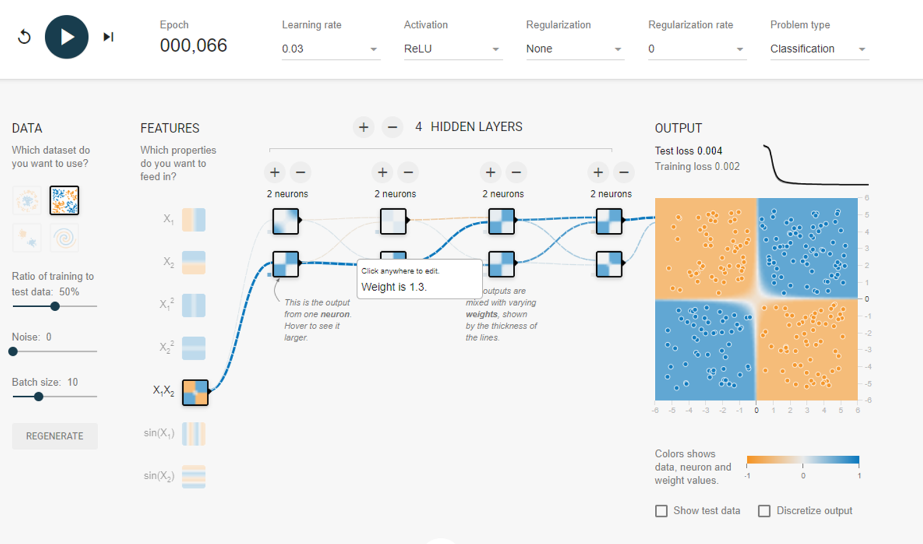
Training – The backwards pass
The strength of the connection between the neurons is initially randomly set. This strength is real number and called a weight.
At the end of the epoch, a calculation is performed that proceeds in reverse thru the neural network, adjusting the weights to minimize the loss.
This is called the backwards pass.

Slide 44
Training – Run lots of epochs
We run through many epochs adjusting the weights to minimize the loss, and at some point we stop when we are satisfied with a suitably low loss.

Slide 45
Training – Model complete!
Now we have a trained model that can classify the training data reasonably well.
But how well does it perform against data it has not seen?

Slide 46
Model Evaluation
That’s were the test data set comes in.
We run all of the test data thru the model and measure the result.
The Test Loss tells us the error of the model against this unseen data.

Slide 47
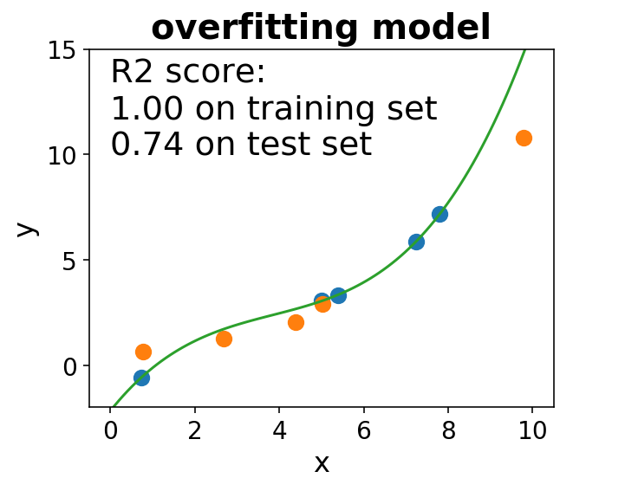
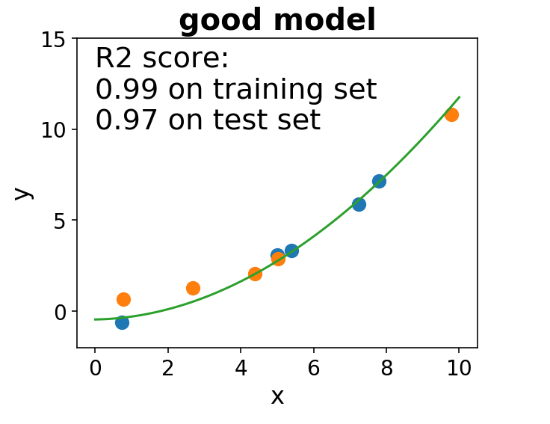
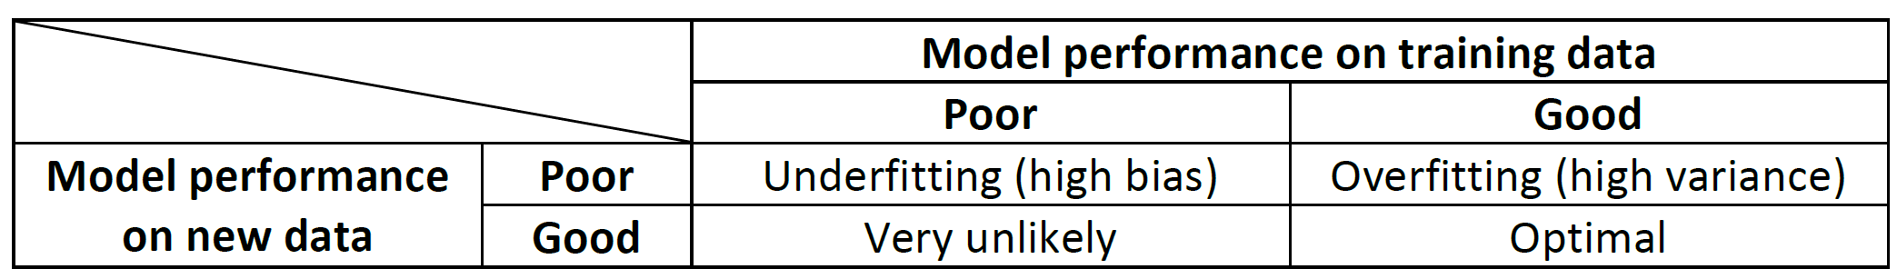
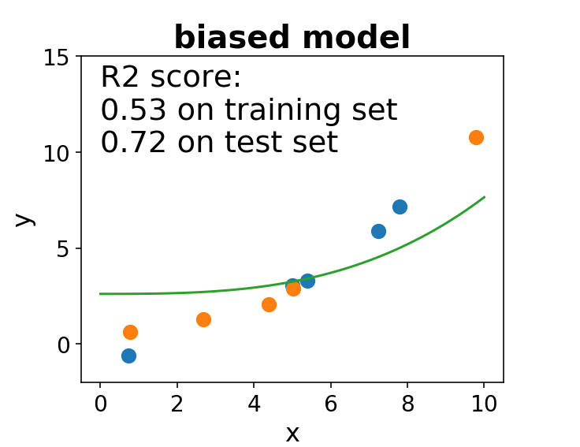
Concept: Overfitting & Underfitting
With Neural Networks, you aim to overfit by having a complex model and then take steps to generalize it (reduce the overfitting).
But that’s the ideal – in reality overfitting often comes with a hefty time and computational cost price.

Slide 48
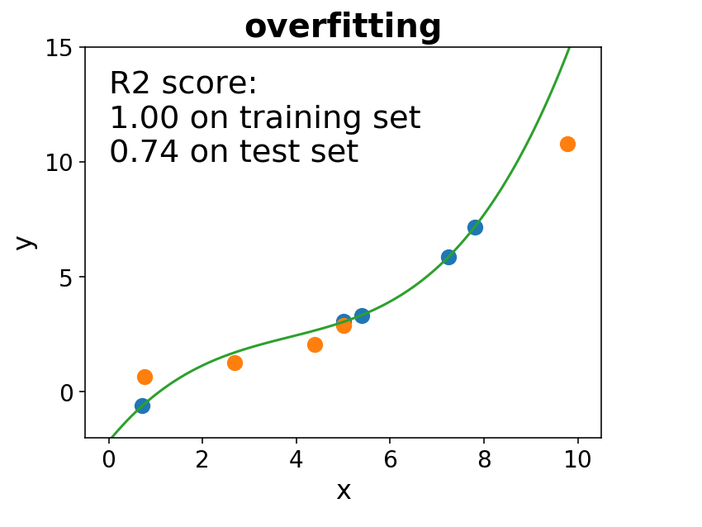
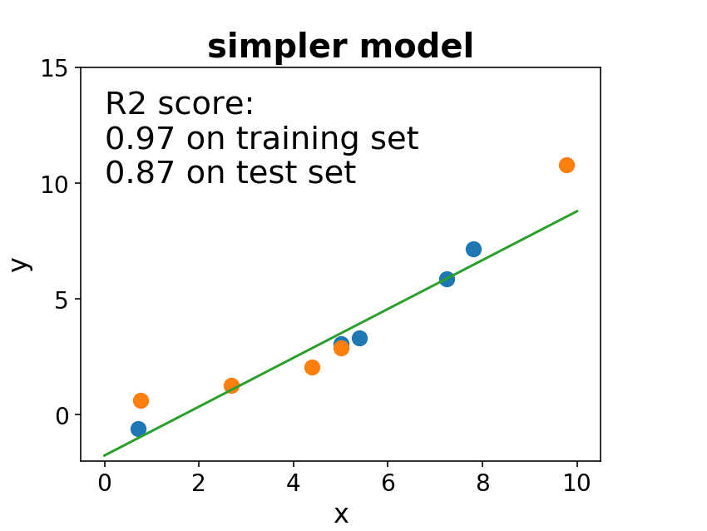
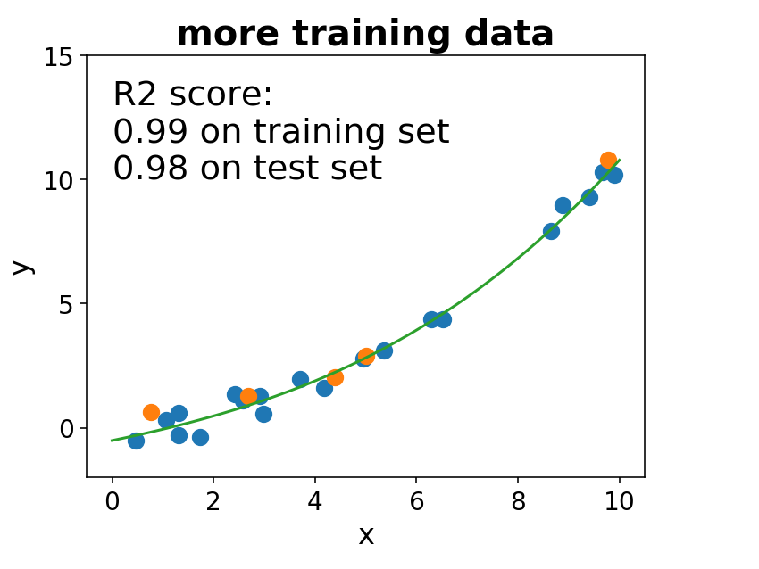
Best Practice Solving the overfitting problem
Solution: Use a simpler model
or
Use regularization
(constraints on parameters)
or
Get more training data

Slide 49
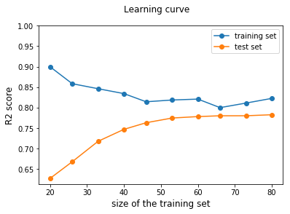
Monitoring Progress – The Learning curve
Pick a small subset of data
Fit model and calculate training and validation/test scores
Repeat for a larger subset of data
Overfitting
(variance)
More data might help.
Underfitting
(bias)
More data will not help.

Slide 50
Model Packaging – Ship it!
Once the model is performing well you typically:
Store the model in a model repository (you version models like you version source code)
Write code to integrate the model in an application
Deploy the model from the repository along with the application that will consume it.

Slide 51
Lab 2
Login to your Azure subscription
Open your Azure Databricks Workspace
In your Workspace open 02 Deep Learning
Complete these notebooks:
01 Deep Learning
02 Neural Nets basic concepts
Explore the basic concepts of neural networks.
Duration: 30 minutes

Slide 52
Becoming a neural-net architect
Picking the right network architecture is more an art than a science; and although there are some best practices and principles you can rely on, only practice can help you become a proper neural-network architect.
- Francois Chollet, Creator of Keras

Slide 53
Concept: Neural Network Architecture
Find the weights that minimize the loss (error), do until satisfied
[[[…, …,]]]
Input Data (vector form)
Weights
[…,…,...,]
Layer
Neuron or Unit
Weights
[…, …]
Layer
Weights
[…]
Layer
[…,…]
Predictions
[…,…]
Targets
(from input data)
optimizer
loss

Slide 54
Concept: Densely Connected Network
Units of a dense layer are connected to every unit in the layer that follows.
Best for: vector data
Typical uses:
Classification
Regression

Slide 55
Training a classification model with text
0
1
1
Document Labels
Supervised DL Algorithm
Documents
Text Normalization Tokenization Part of Speech Tagging
Phrase chunking
Stemming
Lemmatization
Spellcheck
Lowercase
Remove stop words
Expand contractions
Feature Extraction
Define vocabulary
Vectorize documents into vocabulary with TF-IDF
The quick fox.
The lazzy dog.
The rabid hare.
[quick, fox]
[lazy, dog]
[rabid, hare]
vectors
Classification Model
quick | fox | lazy | dog | rabid | hare
0.32 | 0.23 | 0.0 | 0.0 | 0.0 | 0.0
0.0 | 0.0 | 0.12 | 0.23 | 0.0 | 0.0
0.0 | 0.0 | 0.0 | 0.0 | 0.56 | 0.12

Slide 56
Predicting a classification from text
Documents
Text Normalization Tokenization Part of Speech Tagging
Phrase chunking
Stemming
Lemmatization
Spellcheck
Lowercase
Remove stop words
Expand contractions
Feature Extraction
Define vocabulary
Vectorize documents into vocabulary with TF-IDF
The quick fox.
The lazzy dog.
The rabid hare.
[quick, fox]
[lazy, dog]
[rabid, hare]
vectors
Classification Model
quick | fox | lazy | dog | rabid | hare
0.32 | 0.23 | 0.0 | 0.0 | 0.0 | 0.0
0.0 | 0.0 | 0.12 | 0.23 | 0.0 | 0.0
0.0 | 0.0 | 0.0 | 0.0 | 0.56 | 0.12
0
1
1
Document Labels

Slide 57
Example Neural Network Architecture
Classify claim text as home or auto.
Input terms (size of “vocab”)
Hidden layers
Output layer (binary classifier has 2 outputs)
1 (“auto”)
…
0 (“home”)

Slide 58
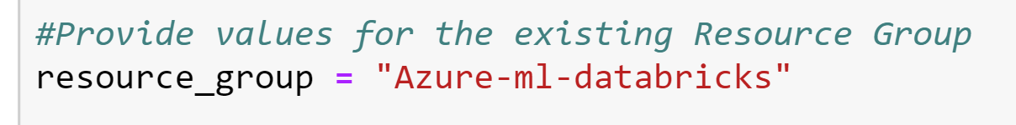
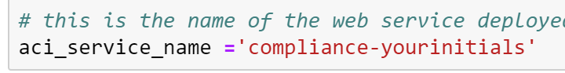
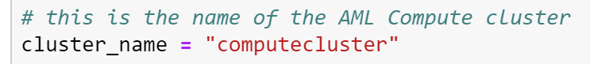
Lab 3
Open http://bit.ly/deep-learning-for-devs
Login to your Azure Notebooks
Clone the Project
In your Project open deep learning for developers
Complete this notebook:
deep-learning.ipynb
Set resource_group (case sensitive!)
Set aci_service_name
Set cluster_name
Learn how to use neural networks for classifying text data, then learn how to convert the DNN to ONNX and deploy the model as a web service using the AML service.
Duration: 90 minutes

Slide 59
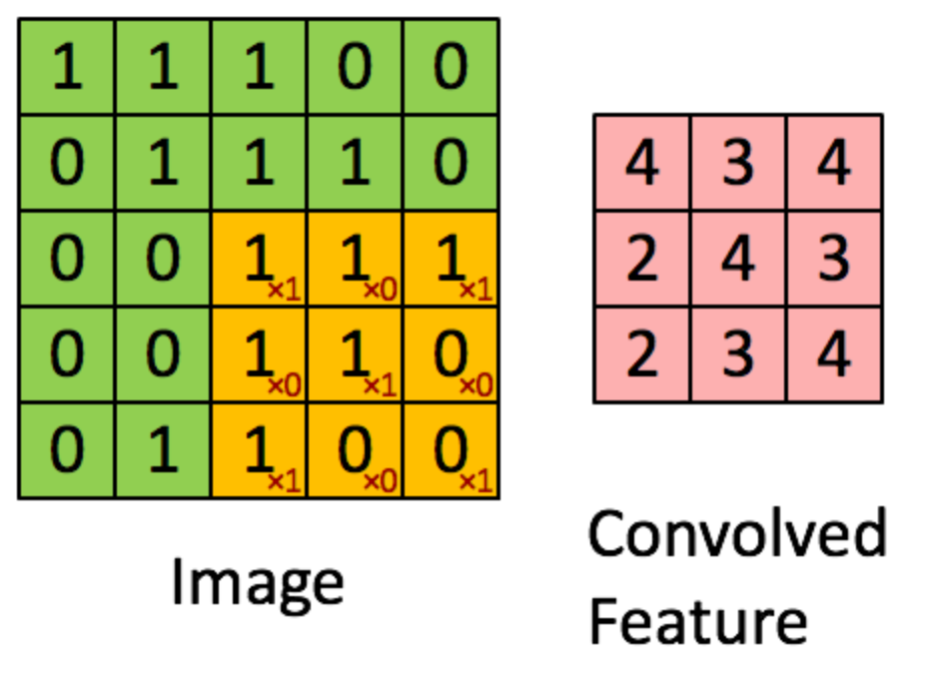
Concept: Convolutional Neural Network (CNN)
Consist of stacks of convolution and max-pooling layers.
Apply a convolution function as window that slides across the data, applying some function to the data within that window.
Results in representations that are translation invariant.
Best for:
Sequences (1D conv)
Images (2D conv)
Video (3D conv)
Typical uses:
Image classification
Image segmentation
Conv Layer
Max-Pooling Layer
Dense Layer

Slide 60
Lab 4
Login to your Azure subscription
Open your Azure Databricks Workspace
In your Workspace open 02 Deep Learning
Complete these notebooks:
04 Image classification with Azure Databricks
Learn about more advanced neural network topics including convolutional neural networks (CNN) and autoencoders while building a model that supports search by image.
Duration: 120 minutes

Slide 61
Concept: Recurrent Neural Network (RNN)
Recurrent Layer
Process sequences one set at a time, maintaining state (a vector or set of vectors).
Think each unit has a nest a for loop.
Used with sequences where data is not temporally invariant (e.g., most recent data more important than older data)
Best for:
Time series data
Sequences of data
Typical uses:
Forecasting on time series data
Natural Language Processing (text)
Recurrent Layer
Dense Layer

Slide 62
Demo
Predicting temperature from weather data
Handling time series data with RNNs.
Duration: 10 minutes
Notes:
Time Series.ipynb (local)

Slide 63
What about ML.NET?
ML.NET provides some data prep and pipeline capabilities
Experience integrated with Visual Studio
For machine learning, ML.NET supports:
Training & scoring
Robust set of algorithms (regression, classification, anomaly detection, recommendation)
Automated machine learning (Auto ML)
For deep learning, ML.NET supports:
Transfer learning only (and only on the final layer of the DNN)
Scoring using TensorFlow models

Slide 64
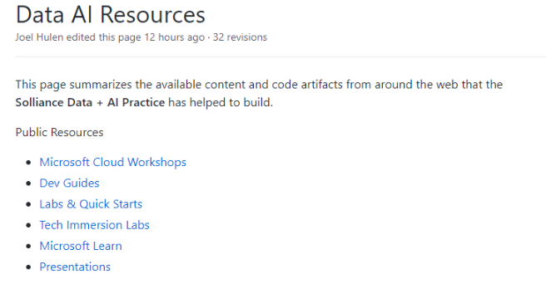
Want more reading and labs?
Solliance has created a lot of content that is available for free to you:
Visit http://bit.ly/solliance-data-ai-resources

Slide 65
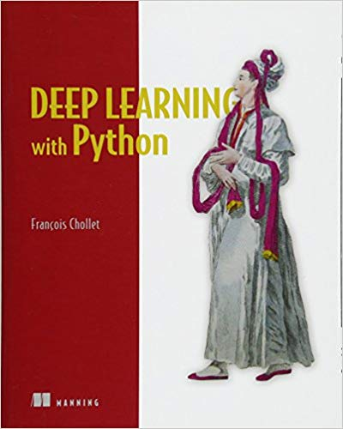
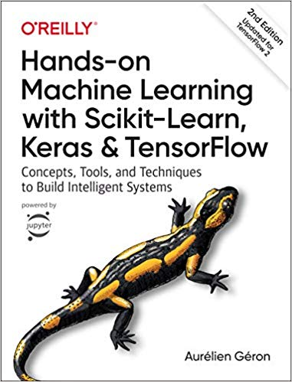
Want more reading and labs?
For Keras, recommend:

Slide 66
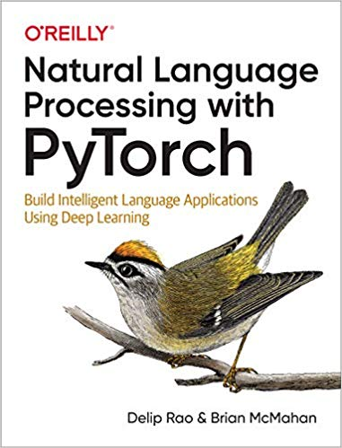
Want more reading and labs?
For PyTorch, recommend:

Slide 67
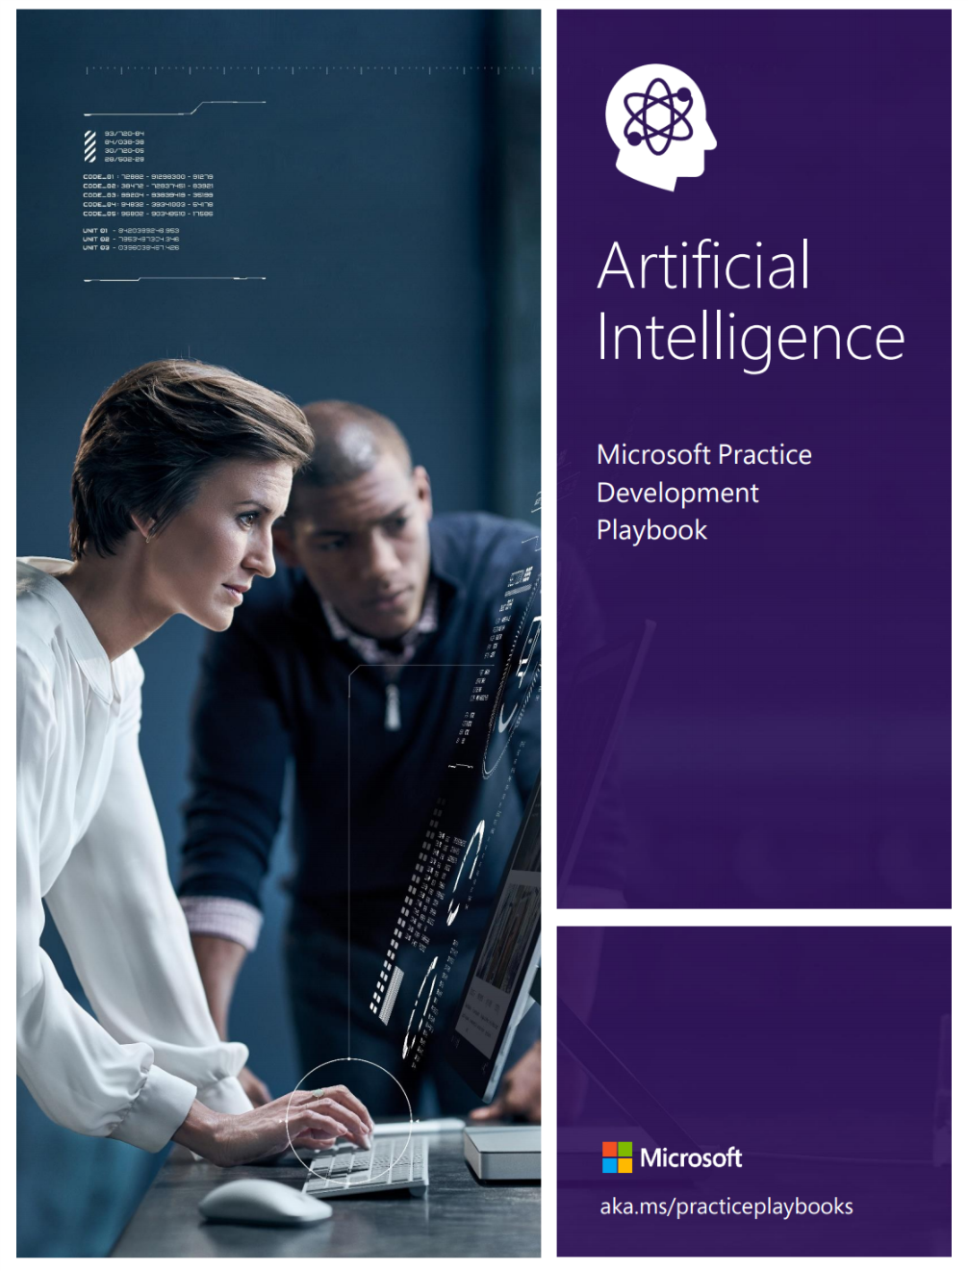
Get the AI Playbook (aka.ms/aiplaybook)

Slide 68
Thank you!
Solliance Founder, CEO
Author of a dozen books on Azure
Microsoft Azure MVP
Microsoft Regional Director
Zoiner Tejada
zoinertejada@solliance.net
@zoinertejada

